Slide 1
Combinational Logic Circuits
Prof. Mr. Yogesh J. Gaikwad
Department of Information Technology
#Education with Values
MAEER's MIT Polytechnic, Department of Information Technology

Slide 2
Points to be Covered
Standard Boolean Representation
Karnaugh Maps (K-map)
Adder and Subtractor
Arithmetic circuits
Multiplexer and Demultiplexer
#Education with Values
MAEER's MIT Polytechnic, Department of Information Technology
MAEER's MIT Polytechnic, Department of Information Technology

Slide 3
Standard Boolean Representation
Sum of Product (SOP)
Product of Sum (POS)
#Education with Values
MAEER's MIT Polytechnic, Department of Information Technology
#Education with Values
MAEER's MIT Polytechnic, Department of Information Technology

Slide 4
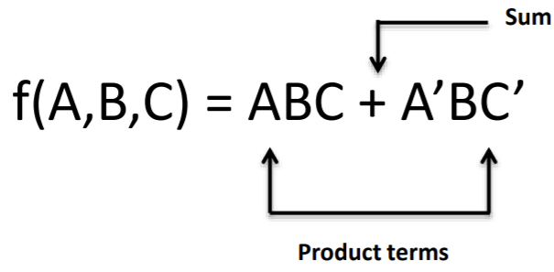
Sum of Product
The sum-of-products (SOP) form is a method (or form) of simplifying the Boolean expressions of logic gates.
Sum and product derived from the symbolic representations of the OR and AND functions.
OR (+) , AND ( . ) , addition and multiplication.
#Education with Values
MAEER's MIT Polytechnic, Department of Information Technology
#Education with Values
MAEER's MIT Polytechnic, Department of Information Technology

Slide 5
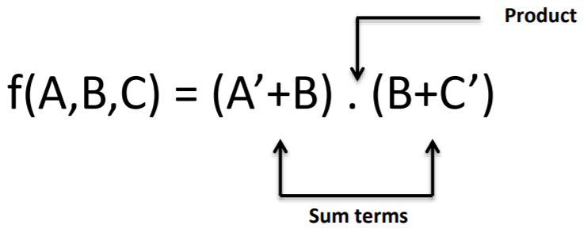
Product of Sum
When two or more sum terms are multiplied by a Boolean OR operation.
Sum terms are defined by using OR operation and the product term is defined by using AND operation.
#Education with Values
MAEER's MIT Polytechnic, Department of Information Technology
#Education with Values
MAEER's MIT Polytechnic, Department of Information Technology

Slide 6
Canonical Form
In SOP or POS form, all individual terms do not involve all literals.
For example AB + A’BC the first product term do not contain literal C.
If each term in SOP or POS contain all literals then the expression is known as standard or canonical form.
#Education with Values
MAEER's MIT Polytechnic, Department of Information Technology
#Education with Values
MAEER's MIT Polytechnic, Department of Information Technology

Slide 7
Canonical Form
Each individual term in the POS form is called Maxterm.
Each individual term in the SOP form is called Minterm.
In Minterm, we look for the functions where the output results is “1”.
While in Maxterm we look for function where the output results is “0”.
We perform Sum of Minterm also known as Sum of products (SOP).
We perform Product of Maxterm also known as Product of sum (POS).
#Education with Values
MAEER's MIT Polytechnic, Department of Information Technology
#Education with Values
MAEER's MIT Polytechnic, Department of Information Technology

Slide 8
Minterms
Minterms are AND terms with every variable present in either true or complemented form.
Given that each binary variable may appear normal (e.g., x) or complemented (e.g.x’ ), there are 2n minterms
Example: Two variables (X and Y)produce 2 x 2 = 4 combinations:
XY(both normal)
XY’(X normal, Y complemented)
X’Y(X complemented, Y normal)
X’Y’(both complemented)
Thus there are four minterms of two variables.
#Education with Values
MAEER's MIT Polytechnic, Department of Information Technology
#Education with Values
MAEER's MIT Polytechnic, Department of Information Technology

Slide 9
Maxterms
Maxterms are OR terms with every variable in true or complemented form.
Given that each binary variable may appear normal (e.g., x) or complemented (e.g. x’), there are 2n maxterms for n variables.
Example: Two variables (X and Y) produce 2x2=4 combinations:
X+Y(both normal)
X+Y’(x normal, y complemented)
X’+Y(x complemented, y normal)
X’+Y’(both complemented)
#Education with Values
MAEER's MIT Polytechnic, Department of Information Technology
#Education with Values
MAEER's MIT Polytechnic, Department of Information Technology

Slide 10
Karnaugh Maps
Karnaugh Maps offer a graphical method of reducing a digital circuit to its minimum number of gates.
The map is a simple table containing 1s and 0s that can express a truth table or complex Boolean expression describing the operation of a digital circuit.
#Education with Values
MAEER's MIT Polytechnic, Department of Information Technology
#Education with Values
MAEER's MIT Polytechnic, Department of Information Technology

Slide 11
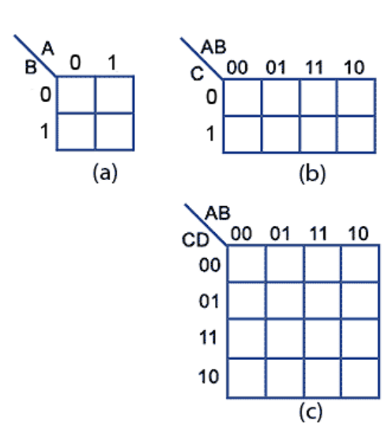
2 input circuits with inputs A and B require maps with 2² = 4 cells (Fig a)
3 input circuits with inputs A B and C require maps with 2³ = 8 cells (Fig b)
4 input circuits with inputs A B C and D require maps with 2⁴ = 16 cells (Fig c)
#Education with Values
MAEER's MIT Polytechnic, Department of Information Technology
#Education with Values
MAEER's MIT Polytechnic, Department of Information Technology

Slide 12
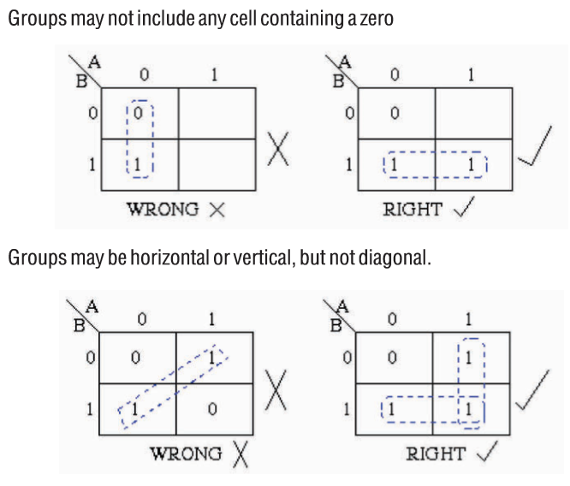
Rules of Simplification for K-Map
The K-Map uses the following rules for the simplification of expressions by grouping together adjacent cells containing ones.
#Education with Values
MAEER's MIT Polytechnic, Department of Information Technology
#Education with Values
MAEER's MIT Polytechnic, Department of Information Technology

Slide 13
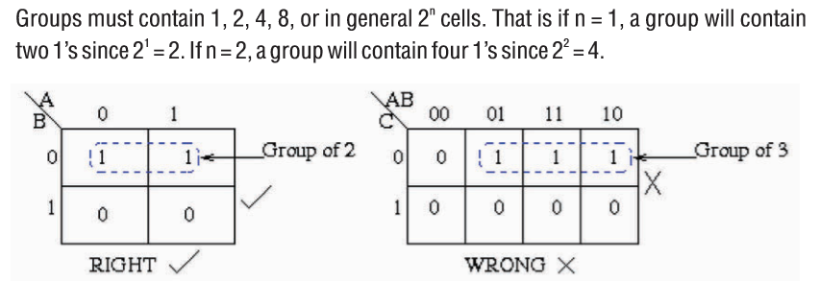
#Education with Values
MAEER's MIT Polytechnic, Department of Information Technology
#Education with Values
MAEER's MIT Polytechnic, Department of Information Technology

Slide 14
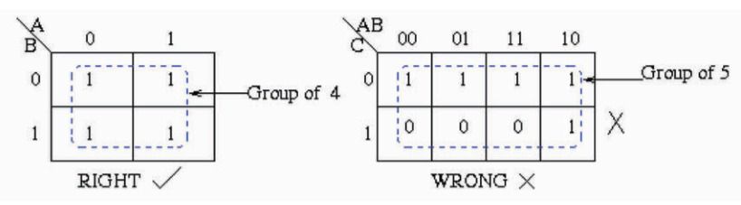
#Education with Values
MAEER's MIT Polytechnic, Department of Information Technology
#Education with Values
MAEER's MIT Polytechnic, Department of Information Technology

Slide 15
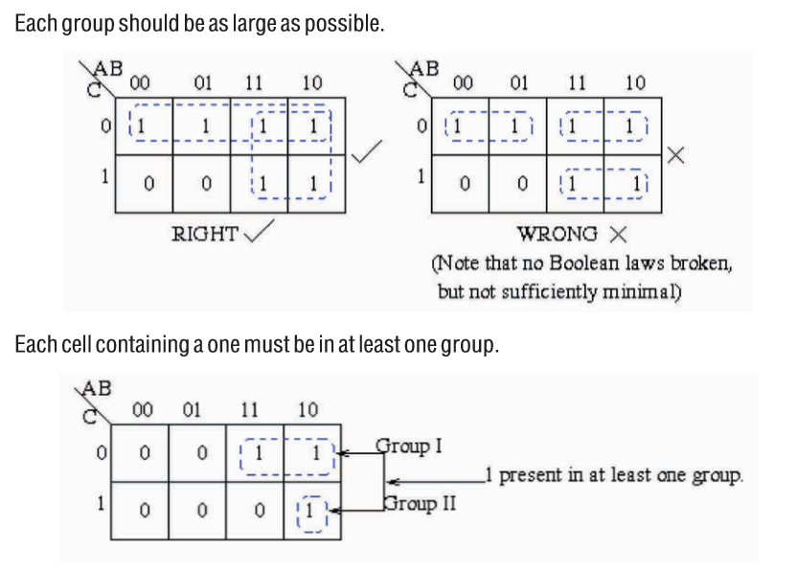
#Education with Values
MAEER's MIT Polytechnic, Department of Information Technology
#Education with Values
MAEER's MIT Polytechnic, Department of Information Technology

Slide 16
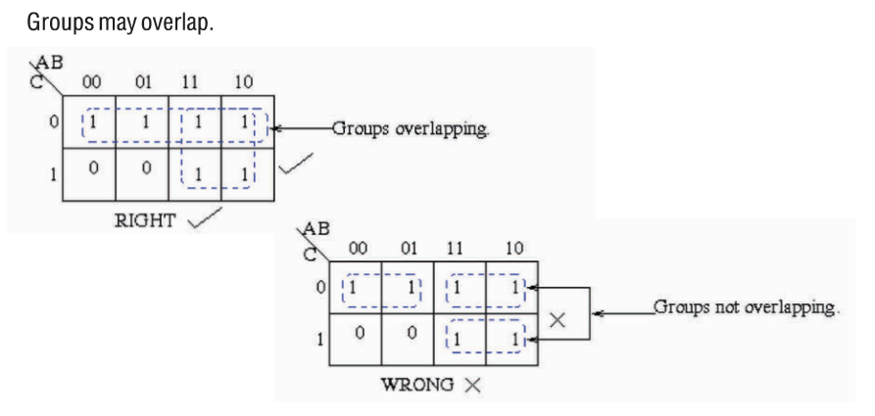
#Education with Values
MAEER's MIT Polytechnic, Department of Information Technology
#Education with Values

Slide 17
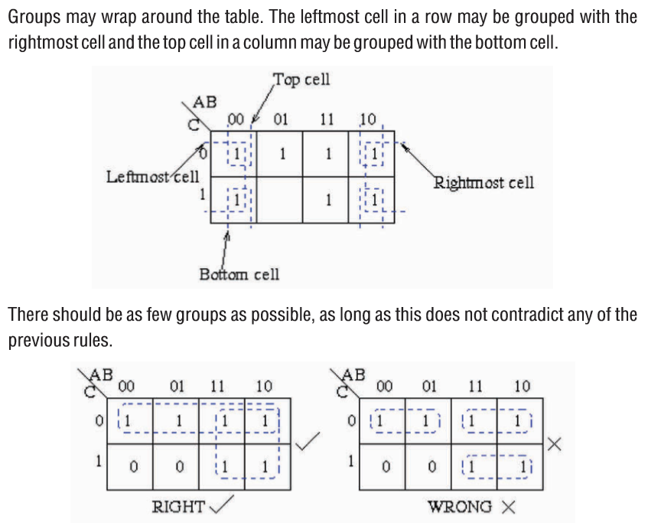
#Education with Values
MAEER's MIT Polytechnic, Department of Information Technology
#Education with Values
MAEER's MIT Polytechnic, Department of Information Technology

Slide 18
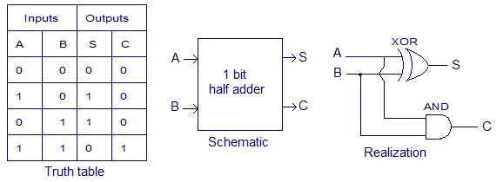
Half Adder
Half adder is a combinational arithmetic circuit that adds two numbers and produces a sum bit (S) and carry bit (C) as the output.
#Education with Values
MAEER's MIT Polytechnic, Department of Information Technology
#Education with Values
MAEER's MIT Polytechnic, Department of Information Technology

Slide 19
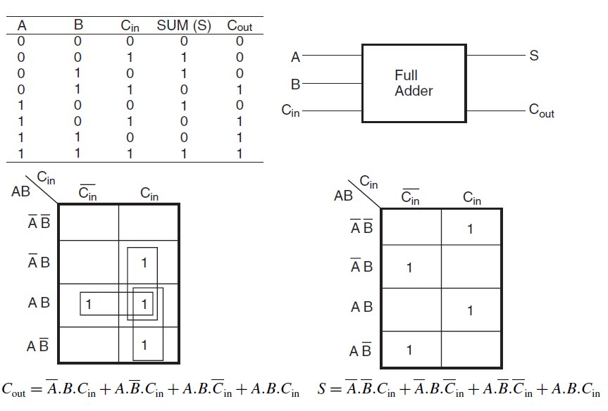
Full Adder
#Education with Values
MAEER's MIT Polytechnic, Department of Information Technology
MAEER's MIT Polytechnic, Department of Information Technology

Slide 20
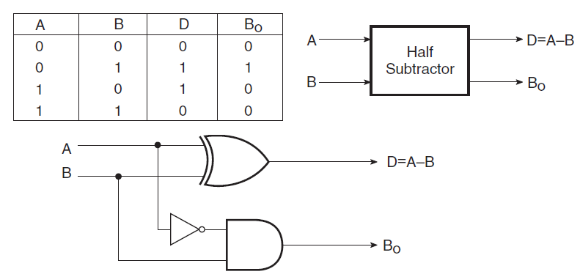
Half Subtractor
A half-subtractor is used to subtract one binary digit from another to produce a difference output and a borrow output.
#Education with Values
MAEER's MIT Polytechnic, Department of Information Technology
#Education with Values
MAEER's MIT Polytechnic, Department of Information Technology

Slide 21
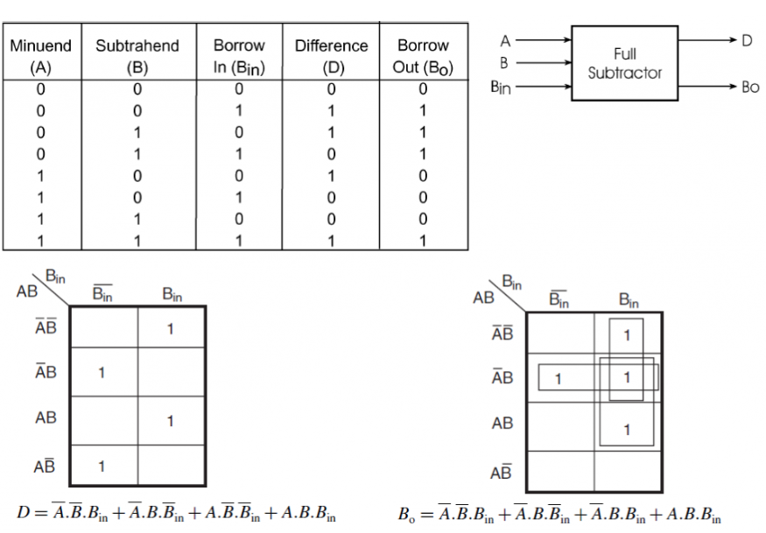
Full Subtractor
#Education with Values
MAEER's MIT Polytechnic, Department of Information Technology
#Education with Values
MAEER's MIT Polytechnic, Department of Information Technology

Slide 22
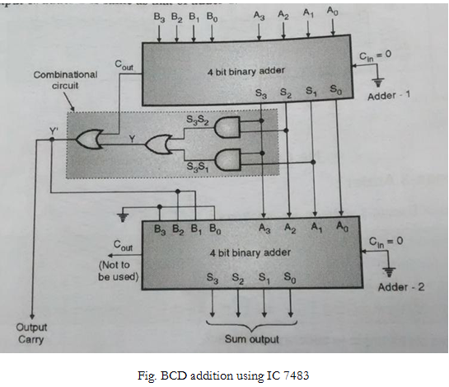
BCD Adder
#Education with Values
MAEER's MIT Polytechnic, Department of Information Technology
#Education with Values
MAEER's MIT Polytechnic, Department of Information Technology

Slide 23
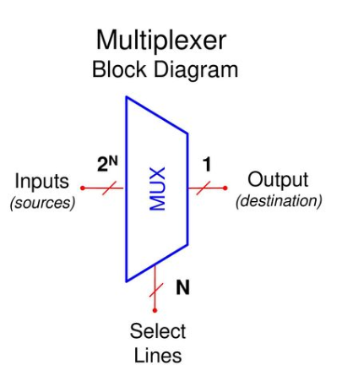
Multiplexer
A MUX is a digital switch that has multiple inputs (sources) and a single output (destination).
The select lines determine which input is connected to the output.
MUX Types
→ 2-to-1 (1 select line)
→ 4-to-1 (2 select lines)
→ 8-to-1 (3 select lines)
→ 16-to-1 (4 select lines)
#Education with Values
MAEER's MIT Polytechnic, Department of Information Technology
#Education with Values
MAEER's MIT Polytechnic, Department of Information Technology

Slide 24
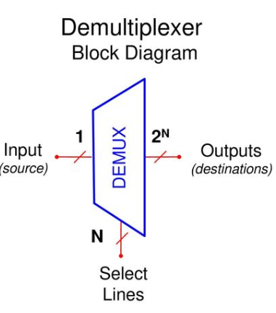
Demultiplexer
A DEMUX is a digital switch with a single input (source) and a multiple outputs (destinations).
The select lines determine which output the input is connected to.
DEMUX Types
→ 1-to-2 (1 select line)
→ 1-to-4 (2 select lines)
→ 1-to-8 (3 select lines)
→ 1-to-16 (4 select lines)
#Education with Values
MAEER's MIT Polytechnic, Department of Information Technology
#Education with Values
MAEER's MIT Polytechnic, Department of Information Technology

Slide 25
THANK YOU
#Education with Values
MAEER's MIT Polytechnic, Department of Information Technology
#Education with Values
MAEER's MIT Polytechnic, Department of Information Technology

